Slide 1


ZOMATO RESTAURANTS IN INDIA
CASE STUDY
A RESEARCH PROJECT BY
ADDREJA CHAKRABORTY

Slide 2
content
  CASE STUDY
  OBJECTIVES
  TABLE ANALYSIS
  IMPORTANT FACTOR TO OPTIMIZE THE BUSINESS
  NUMBER OF RESTAURANTS IN DIFFERENT CITIES
  LOCALITY WHERE MOST NUMBER OF RESTAURANTS FOUND IN TOP FIVE CITIES WITH LARGEST NO. OF RESTAURANTS.
  Locality where most number of restaurants found in top five cities with lesser no. of restaurants
  TOP 10 CITIES WITH MOST EXPENSIVE RESTAURANTS.
  TOP TEN CITIES WITH THE MOST AFFORDABLE RESTAURANTS.
  THE TOP TEN CITIES WITH THE HIGHEST RESTAURANT RATINGS.
  THE TOP TEN CITIES WITH THE LOWEST RESTAURANT RATINGS
  FINDINGS

Slide 3
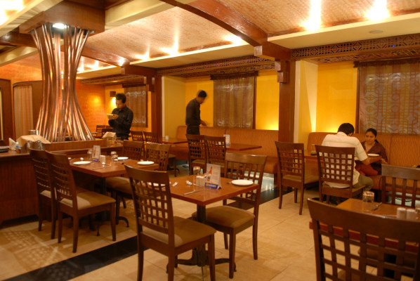
CASE STUDY
  This case study consists a dataset which represents
  The restaurants name with the name of the city where it is located .Also specify the locality.
  The average cost of meal for two peple.
  The price range of the restaurants.
  The overall rating of the restaurants with textual descriptions of the rating.

Slide 4

OBJECTIVES
Analyse the number of restaurants in each city. Publish the findings based on data analysis.

Slide 5
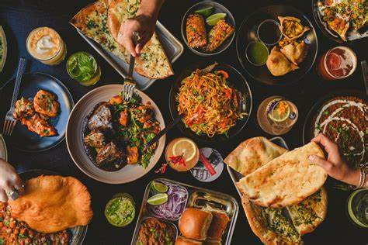
TABLE ANALYSIS
For analysing the data important attributes should be listed out. In this case study, there are a table called 'Restaurants' consisting all details like res_id,res_name,city ,location ,rating,average cost for two ,food details .
06

Slide 6
IMPORTANT FACTOR TO OPTIMIZE THE BUSINESS
  Number of restaurants in different cities.
  Overall rating of different restaurants in each city.
  cost of meals in restaurants.
  Facilities of customers.

Slide 7
NUMBER OF RESTAURANTS IN DIFFERENT CITIES
  Chennai , Mumbai,Bangalore,Pune ,Lucknow have more restaurants.
  Nayagaon, Greater Noida,Howrah,Faridabad,Ghaziabad have lesser no. of restaurants.

Slide 8
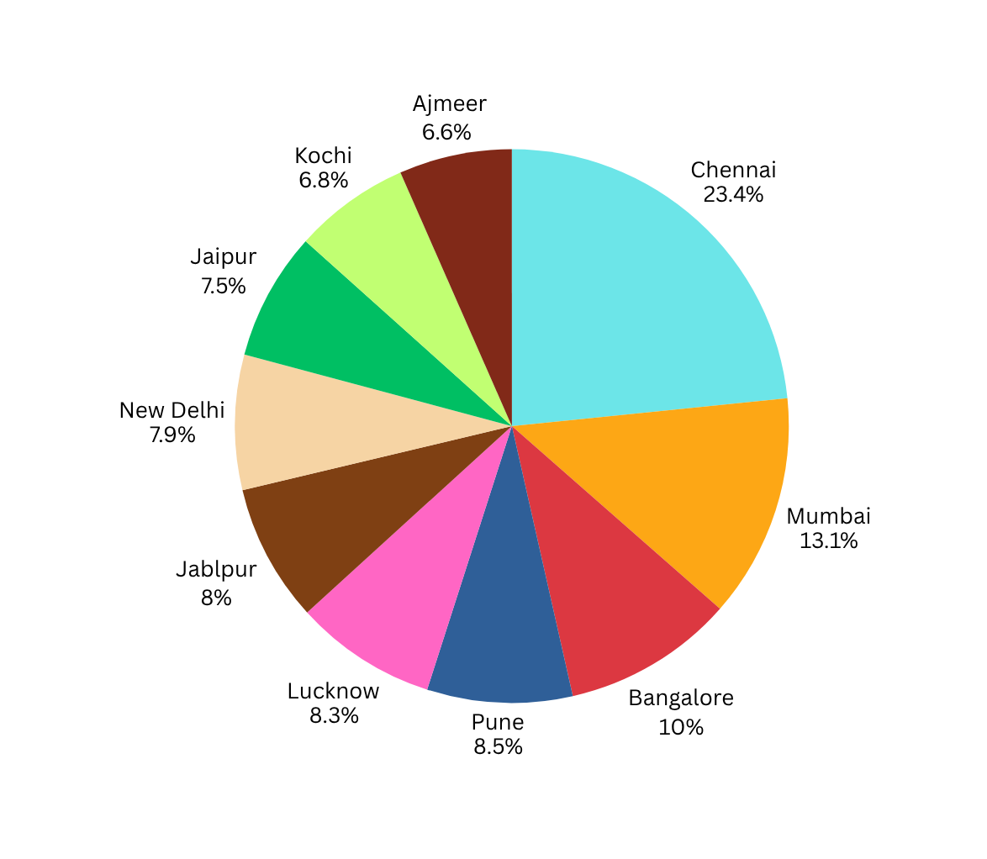
THIS PIE CHART REPRESENTS THE DISTRIBUTION OF THE TOP TEN CITIES WITH THE MOST NUMBER OF RESTAURANTS.

Slide 9
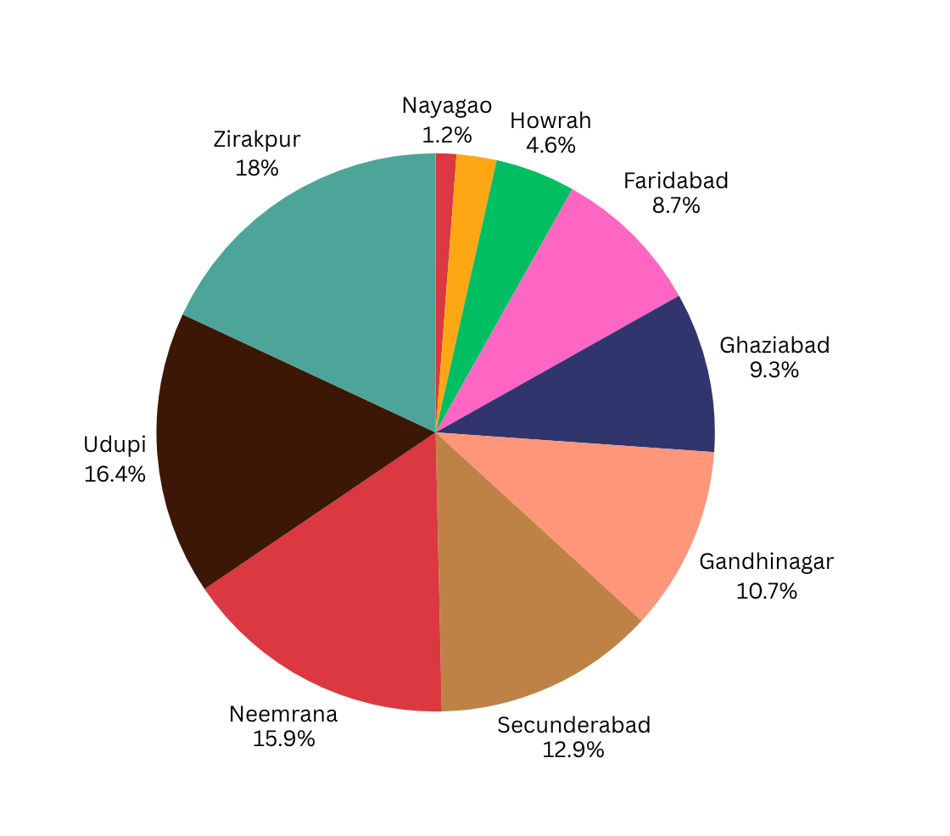
THIS PIE CHART REPRESENTS THE DISTRIBUTION OF THE TOP TEN CITIES WITH THE LESSER NUMBER OF RESTAURANTS.

Slide 10
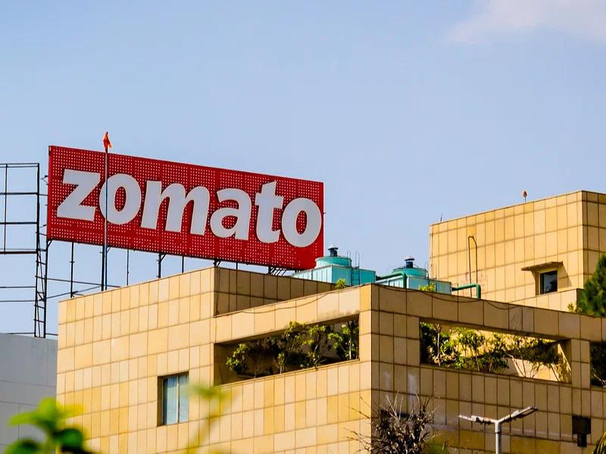
LOCALITY WHERE MOST NUMBER OF RESTAURANTS FOUND IN TOP FIVE CITIES WITH LARGEST NO. OF RESTAURANTS
  The majority of restaurants in Chennai can be found on T.Nagar, Potheri,Nungambakkam,Kodambakkam,Anna Nagar East.
  The majority of restaurants in Mumbai can be found on Powai, Andheri Lokhandwala,Andheri West,Malad West,Borivali West.
  The majority of restaurants in Bangalore can be found on Indiranagar, Koramangala 5th block,HSR.
  The majority of restaurants in Pune can be found on Baner,Koregaon Park,Viman Nagar,Kothrud.
  The majority of restaurants in Lucknow can be found on

Slide 11

LOCALITY WHERE MOST NUMBER OF RESTAURANTS FOUND IN TOP FIVE CITIES WITH LESSER NO. OF RESTAURANTS
  The majority of restaurants in Nayagaon can be found on Nayagaon.
  The majority of restaurants in Greater Noida can be found on Delta1,Gaur City 1 , Gaur City 2.
  The majority of restaurants in Howrah can be found on Avani Riverside Mall, Shibpur ,Dobson Road.

Slide 12
  The majority of restaurants in Faridabad can be found on NIT,Sector 16, Vivanta by Taj, Suraj Kund,Sector 25.
  The majority of restaurants in Ghaziabad can be found on Indirapuram,Indirapuram Habitat Centre,Raj Nagar.
Apart from these areas, the quantity of restaurant in other areas is very limited.

Slide 13

TOP 10 CITIES WITH MOST EXPENSIVE RESTAURANTS
The followings cities have the most expensive restaurants:
  Mumbai
  New Delhi
  Gurgaon
  Bangalore
  Pune
  Goa
  Noida
  Hydrabad
  Chennai
  Jaipur

Slide 14

TOP TEN CITIES WITH THE MOST AFFORDABLE RESTAURANTS
The followings cities have the most expensive restaurants:
  Junagadh
  Jamnagar
  Amravati
  Kharagpur
  Jhansi
  Tirupati
  Kota
  Vellore
  Trichy
  Meerut

Slide 15
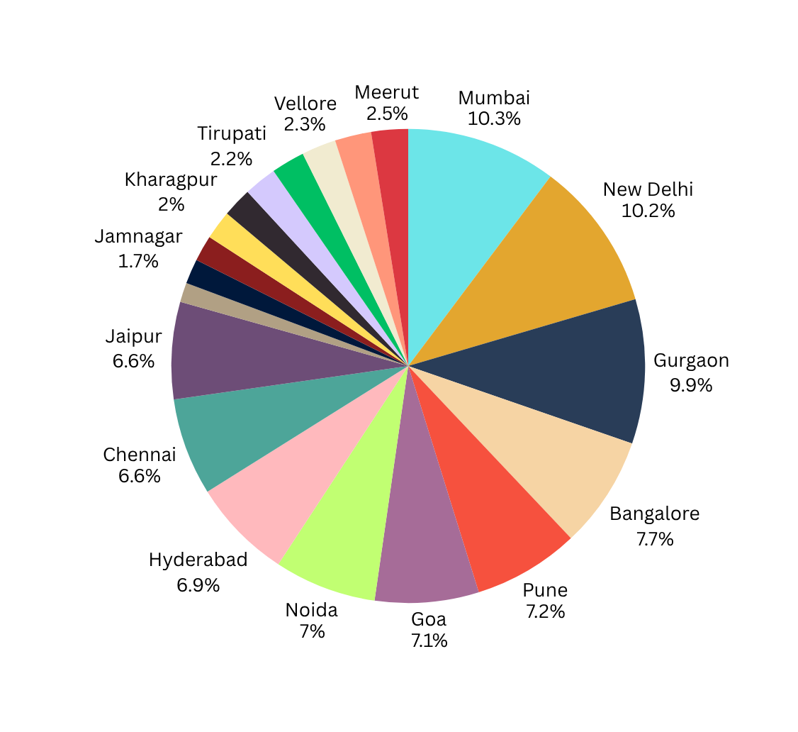
THIS PIE CHART REPRESENTS THE CITIES WITH MOST EXPENSIVE AND MOST AFFORDABLE RESTAURANTS.

Slide 16
THE TOP TEN CITIES WITH THE HIGHEST RESTAURANT RATINGS
The following cities have the highest restaurants ratings:
  Bangalore
  Gurgaon
  Hyderabad
  Secunderabad
  Mumbai
  Chennai
  New Delhi
  Kolkata
  Pune
  Chandigarh

Slide 17
THE TOP TEN CITIES WITH THE LOWEST RESTAURANT RATINGS
The following cties have the lowest restaurants ratings:
  Palakkad
  Alappuzha
  Kharagpur
  Darjeeling
  Pushkar
  Gangtok
  Srinagar
  Nainital
  Ooty
  Nayagaon

Slide 18
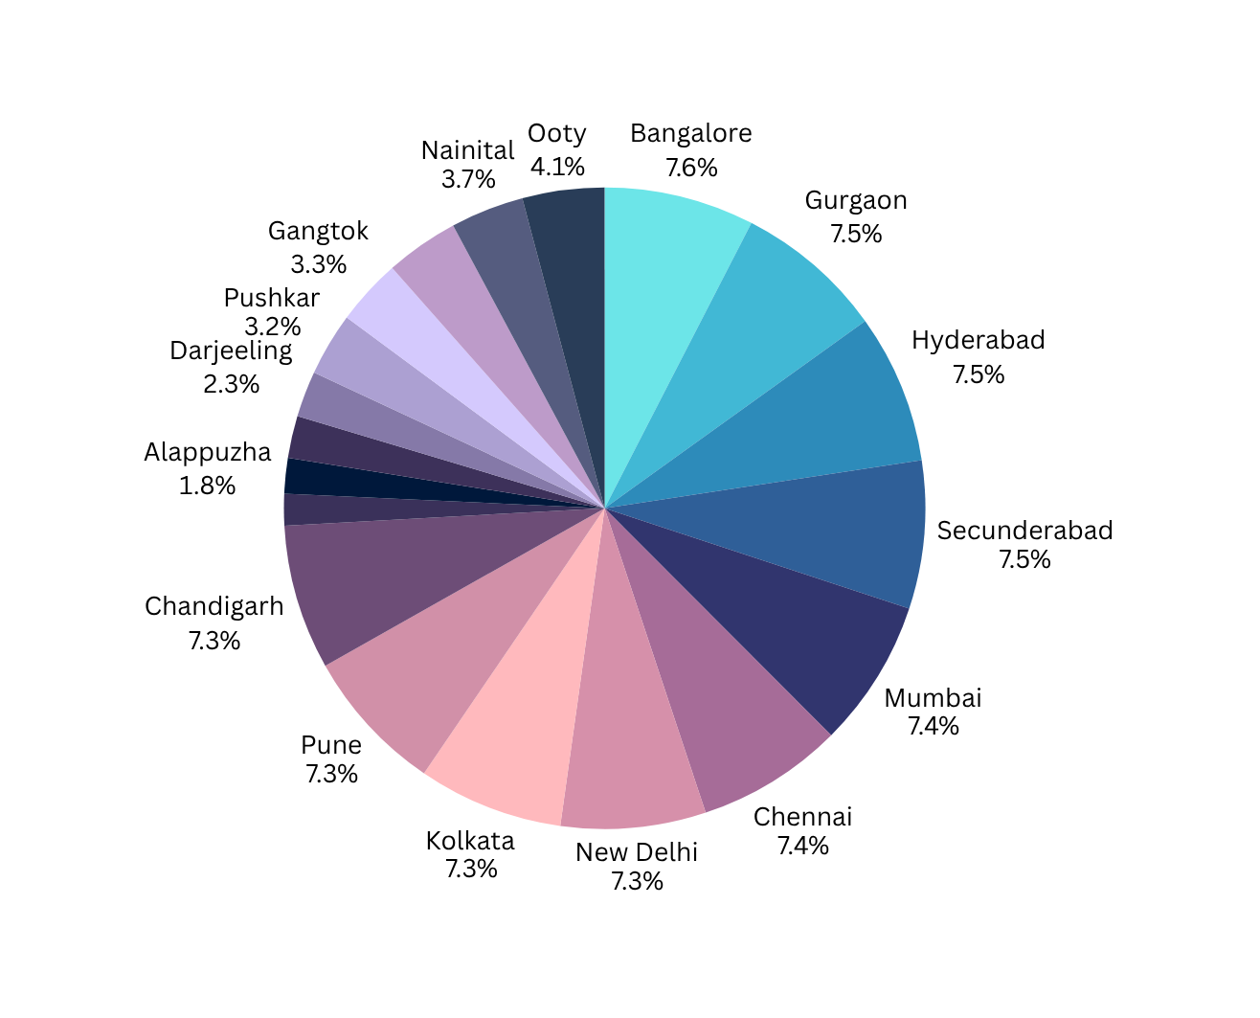
THIS PIE CHART REPRESENTS THE CITIES WITH THE HIGHEST AND LOWEST RESTAURANT RATINGS

Slide 19
FINDINGS
  The number of restaurants should be increase. Specifically for the cities like Gurgaon,Hydrabad ,Kolkata,pune,New delhi,Secunderabad, where the overall rating of the restaurants is good
  Reduce the average cost for two meals in the cities where overall prices are high.Mainly for Mumbai,as the overall ratings and quantity of restaurants are high.
  The overall rating of some cities is very poor.We should improve the quality and facilities of restaurants.

Slide 20
THANK YOU

